Slide 1
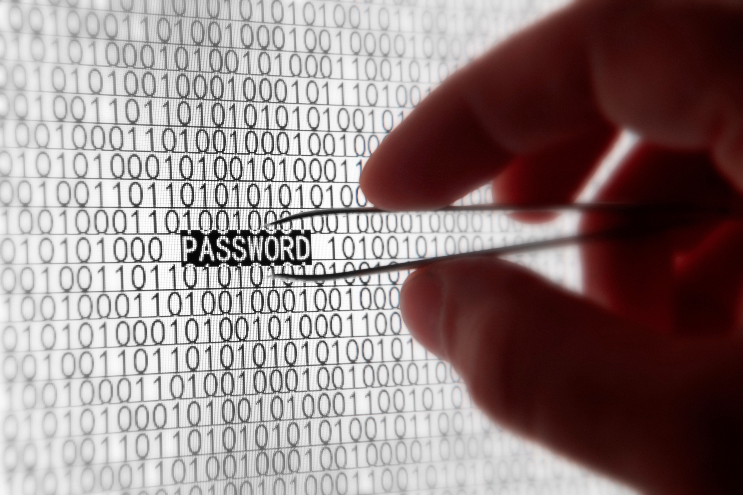

Network Security
Revised August 2013
Chapter 3

Slide 2
Pathfinder
Introductory Chapters
1. Overview and core concepts
2. Standards concepts and key standards
3. Network security
Critical for understanding network planning and management
4. Planning
Notes:
Read the text.

Slide 3

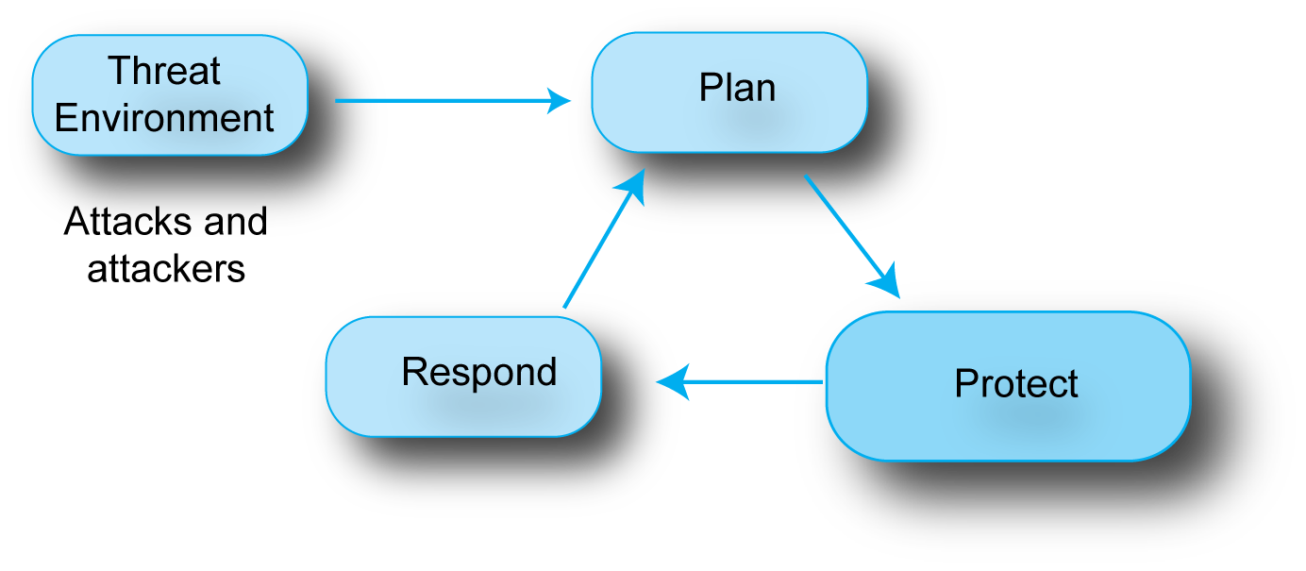
3.1: Threats and Responses
You cannot defend yourself unless you know the threat environment you face.
Notes:
Read the bubble text.

Slide 4
3.1: Threats and Responses
Companies defend themselves with a process called the Plan-Protect-Respond Cycle.
Notes:
Read the bubble text.
Show the flow between the blue bubbles.

Slide 5
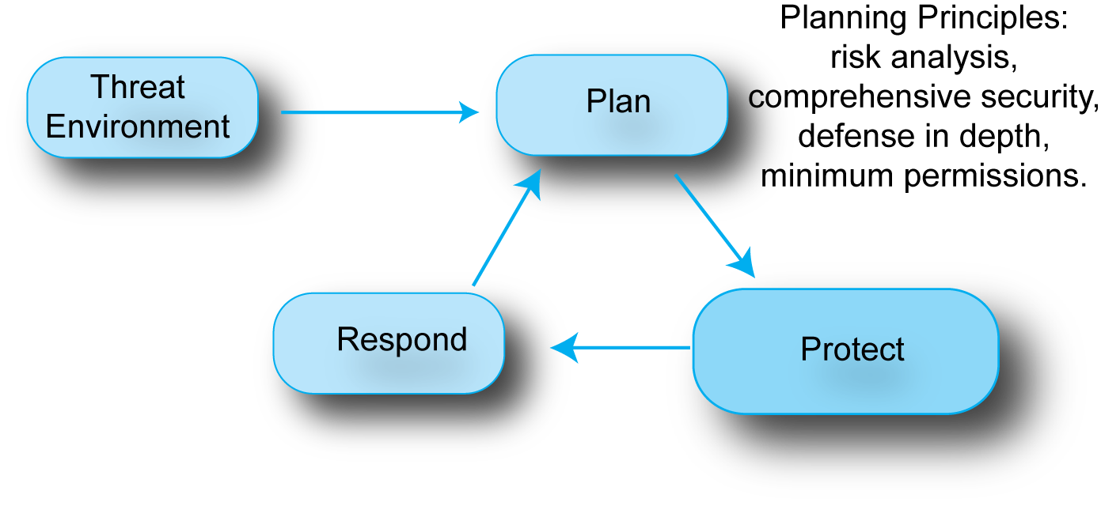
3.1: Threats and Responses
The Plan-Protect-Respond Cycle starts with Planning.
We will look at important planning principles.
Notes:
Read the bubble text.
Describe the items under plan.

Slide 6
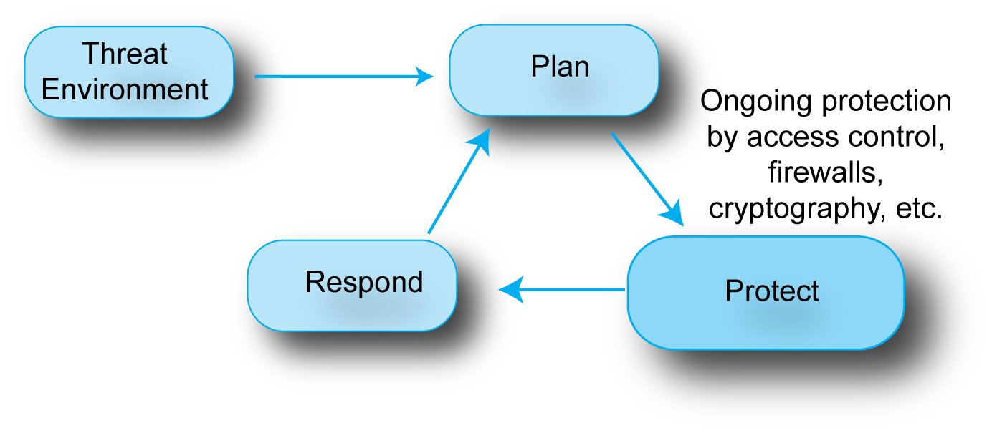
3.1: Threats and Responses
Companies spend most of their security effort on
the protection phase, in which they apply planned protections on a daily basis.
Notes:
Read the bubble text.
Describe the items under protect.

Slide 7
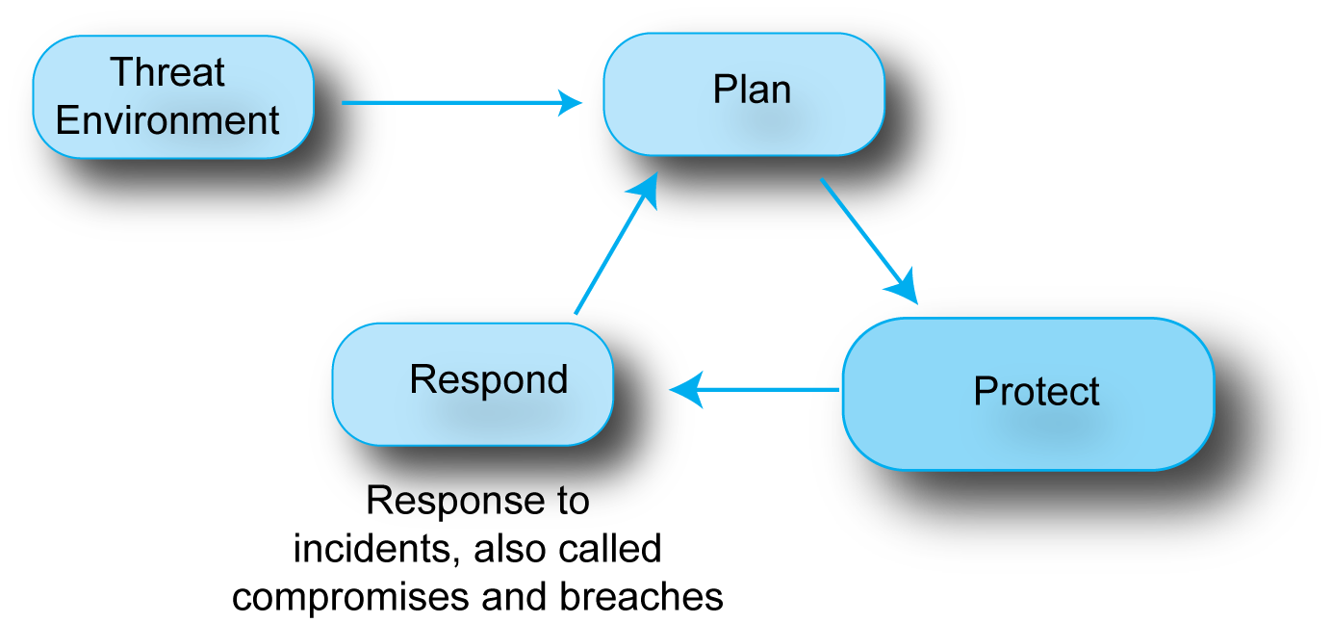
3.1: Threats and Responses
Even with great planning and protection, incidents
will happen, and a company must have a well-rehearsed plan for responding to them.
Notes:
Read the bubble text.
Describe the items under respond.

Slide 8
The Threat Environment
Notes:
We will look first at the threat environment.

Slide 9

3.2: Malware
Malware
A general name for evil software
Vulnerability-Specific versus Universal Malware
Vulnerabilities are security flaws in specific programs.
Vulnerability-specific malware requires a specific vulnerability to be effective.
Universal malware does not require a specific vulnerability to be effective.
Notes:
Read the text.
Emphasize the text indicated.

Slide 10

3.2: Malware
Vendors release patches to close vulnerabilities.
However, users do not always install patches promptly or at all and so continue to be vulnerable.
Also, zero-day attacks occur before the patch is released for the vulnerability.
Notes:
Read the text.
Emphasize the importance of this and the problem students have with this concept.

Slide 11
3.2: Malware
Virus
Program
Viruses
Pieces of code that attach themselves to other programs.
Virus code executes when an infected program executes.
The virus then infects other programs on the computer.
Infected
Program
Other
Program
Notes:
Read the text.

Slide 12

3.2: Malware
Viruses
Virus propagation vectors between hosts
E-mail attachments
Visits to websites (even legitimate ones)
Social networking sites
Many others (USB RAM sticks, peer-to-peer file sharing, etc.)
Notes:
Read the text.

Slide 13
3.2: Malware
Viruses
Stopping viruses
Antivirus programs are needed to scan arriving files for viruses.
Antivirus programs also scan for other malware.
Patching vulnerabilities may help but may not.
Notes:
Read the text.

Slide 14

3.2: Malware
Worms
Viruses, as just noted, are pieces of code that attach themselves to other programs.
Worms, in contrast, are stand-alone programs that do not need to attach to other programs.
Can propagate like viruses through e-mail, and so on.
This requires human gullibility, which is slow.
Antivirus programs search for worms as well as viruses.
Notes:
Read the text
Emphasize the text outlined in red.

Slide 15

3.2: Malware
Worms
Directly-propagating worms jump to victim hosts directly.
Can only do this if target hosts have a specific vulnerability.
Directly-propagating worms can spread with amazing speed.
Directly-propagating worms can be thwarted by firewalls and by installing patches.
Not by antivirus programs.
Notes:
Read the text
Emphasize the text outlined in red.
Emphasize that some students have a hard time learning this.

Slide 16
3.3: Stopping Viruses and Worms
Propagation Vector | Antivirus Program Can Stop? | Firewall Can Stop? | Patching Can Stop?
Normally propagating virus or worm | Yes | No | Sometimes
Directly-propagating worm | No | Yes | Yes
There are no directly-propagating viruses
Notes:
Go through the table one row at a time.

Slide 17
3.2: Malware
Mobile Code
HTML webpages can contain scripts.
Scripts are snippets of code in a simplified programming language that are executed when the webpage is displayed in a browser.
A common scripting language is JavaScript.
Scripts are called mobile code because they are downloaded with the webpage.
Notes:
Read the text
(You might ask if some students have worked with scripting languages. Have them describe them.)

Slide 18
3.2: Malware
Mobile Code
Scripts enhance the user experience and may be required to see the webpage.
Scripts are normally benign but may be damaging if the browser has a vulnerability.
The script may do damage by itself or download a program to do damage.
Notes:
Read the text

Slide 19
3.2: Malware
Payloads
After propagation, viruses and worms execute their payloads.
Payloads erase hard disks, send users to pornography sites if they mistype URLs, etc.
Often, the payload downloads another program.
An attack program with such a payload is called a downloader.
Notes:
Read the text.

Slide 20
3.2: Malware
Payloads
Many downloaded programs are Trojan horses.
Trojan horses are stand-alone programs that disguise themselves as system files.
Spyware Trojans collect sensitive data and send the data they collect to an attacker.
Website activity trackers
Keystroke loggers
Data mining software
Notes:
Read the text.
Emphasize that students need to know the definition of “Trojan horse”.
Emphasize that website activity trackers, keystroke loggers, and data mining software are all types of spyware.

Slide 21
3.2: Malware
Getting Infected
E-mail from infected machines or spammers
Visiting websites
Even normally legitimate websites can be seeded with pages containing mobile malware
Peer-to-peer file transfers
Downloading “free” software
And so on

Slide 22
3.4: Attacks on Individuals
Social Engineering
Tricking the victim into doing something against his or her interests
Fraud
Lying to the user to get the user to do something against his or her financial self-interest
Spam
Unsolicited commercial e-mail
Notes:
Read the text.

Slide 23
3.4: Attacks on Individuals
E-Mail Attachments
Including a Link to a Website that Has Malware
The website may complete the fraud or download software to the victim.
Phishing Attacks
Sophisticated social engineering attacks in which an authentic-looking e-mail or website entices the user to enter his or her username, password, or other sensitive information.
Notes:
Read the text.

Slide 24
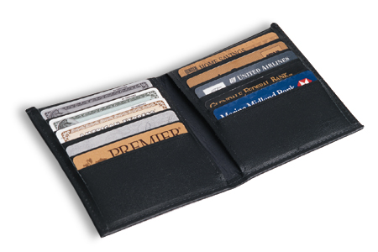

3.4: Attacks on Individuals
Credit Card Number Theft
Performed by “carders”
Make purchases with stolen credit card numbers
Identity Theft
Collecting enough data to impersonate the victim in large financial transactions
Can result in much greater financial harm to the victim than carding
May take a long time to restore the victim’s credit rating
Notes:
Read the text.
Emphasize the differences between carding and identity theft

Slide 25
3.4: Attacks on Individuals
Identity Theft
In corporate identity theft, the attacker impersonates an entire corporation.
Accept credit cards in the company’s name.
Commit other crimes in the name of the firm.
Can seriously harm a company’s reputation.
Notes:
Read the text.

Slide 26
3.5: Human Break-Ins
Human Break-Ins
Viruses and worms have only a single attack method.
Humans can keep trying different approaches until they succeed.
Hacking
Informally, hacking is breaking into a computer.
Notes:
Read the text.
Emphasize the need to understand all terms in the definition in hacking.

Slide 27

3.5: Human Break-Ins
Hacking
Informally, hacking is breaking into a computer.
Formally, hacking is intentionally using a computer resource without authorization or in excess of authorization.
If you find someone’s username and password on a sheet of paper in the trash, and if you log in, have you hacked? Justify your answer.
Notes:
Reread the definition.
Go through the question.
The answer is, “Yes.” Finding the password did not give you authorization to use it.

Slide 28
3.5: Human Break-Ins
Hacking
Formally, hacking is intentionally using a computer resource without authorization or in excess of authorization
When you log into your authorized user account, you discover that you can see sensitive information in another directory. You just spend a few minutes there. Have you hacked? Justify your answer.
Notes:
Reread the definition.
Go through the question.
The answer is, “Yes.” You do not have explicit authorization to read information in the directory.

Slide 29
3.5: Human Break-Ins
Hacking
Formally, hacking is intentionally using a computer resource without authorization or in excess of authorization.
Someone sends you a link to a game site. When you go there, you find that you actually are in a sensitive directory on a server. You log out immediately. Have you hacked? Justify your answer.
Notes:
Reread the definition.
Go through the question.
The answer is, “No.” You did use the resource without authorization, but it was not intentional.

Slide 30
3.5: Human Break-Ins
Hacking
Formally, hacking is intentionally using a computer resource without authorization or in excess of authorization
A company has no strong security in place. To demonstrate this, you log into the server without authorization. Is this hacking? Justify your answer.
Notes:
Reread the definition.
Go through the question.
The answer is, “Yes.” Lack of good security does not mean that you have authorization to use the system.

Slide 31
3.5: Human Break-Ins
Typical Stages in a Human Break-In
Scanning Phase (Figure 3-6)
The Break-In
After the Break-In
Notes:
Reread the definition.

Slide 32
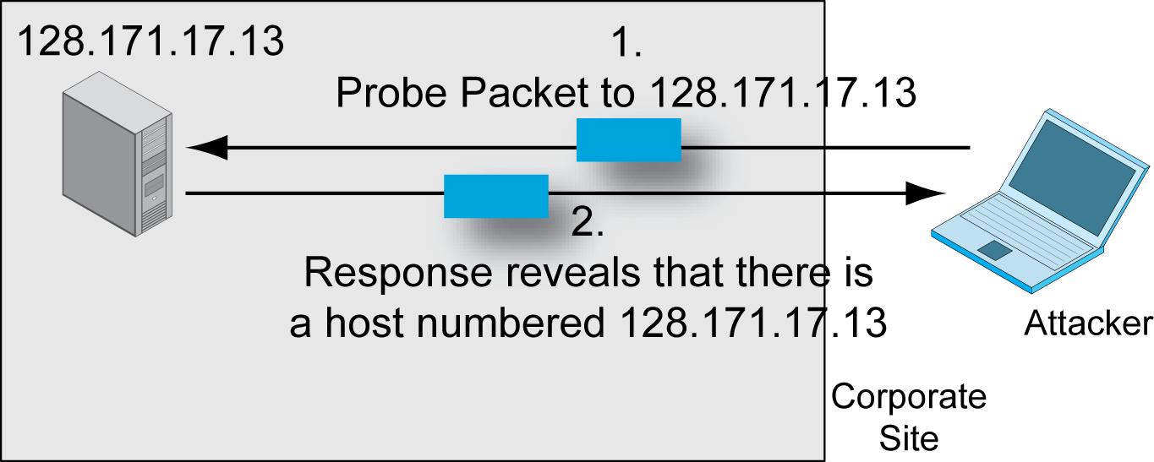
3.6: Probes and Exploits
First round of probe packets, such as
pings, identifies active IP addresses
and therefore potential victims.
Notes:
Read the bubble text.
Then go through the figures right to left.

Slide 33
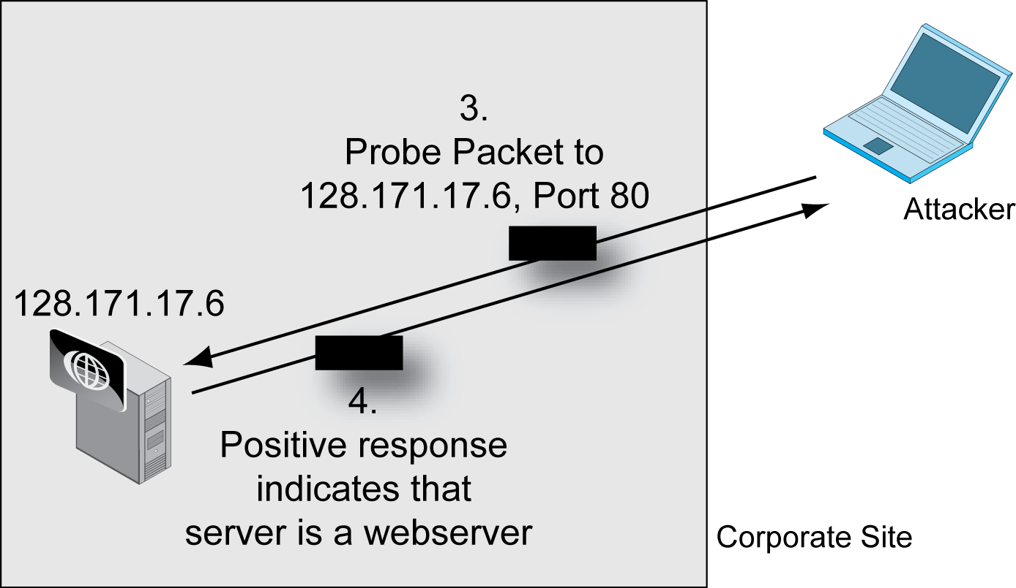
3.6: Probes and Exploits
Second round
sends packets to specific ports
on identified potential victims to identify applications.
Notes:
Read the bubble text.
Then go through the figures right to left.

Slide 34
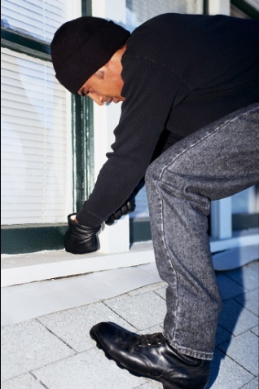
3.5: Human Break-Ins
Stage 2: The Break-In
Uses an exploit—a tailored attack method that is often a program (Figure 3-6).
Normally exploits a vulnerability on the victim computer.
The act of breaking in is called an exploit.
The hacker tool is also called an exploit.
Notes:
Read the text.

Slide 35
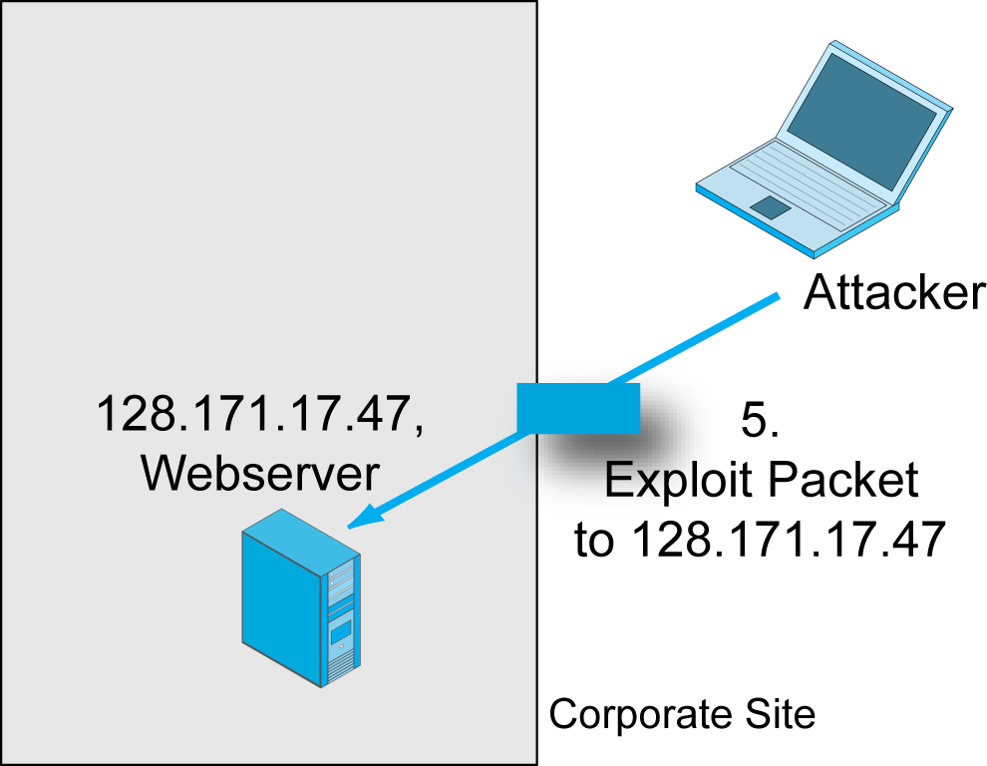
3.6: Probes and Exploits
Notes:
Go through the figures right to left.

Slide 36
3.5: Human Break-Ins
Stage 3: After the Break-In
1. The hacker downloads a hacker tool kit onto the victim host to automate hacking work.
2. The hacker becomes invisible by deleting log files.
3. The hacker creates a backdoor (way to get back into the computer).
Backdoor account—account with a known password and full privileges.
Backdoor program—program to allow reentry; usually Trojanized to make detection difficult.
Notes:
Go through the recap.

Slide 37
3.5 Human Break-Ins
Stage 3: After the Break-In
The hacker can then do damage at his or her leisure.
Manually give operating system commands to do damage.
Download a Trojan horse to continue exploiting the computer after the attacker leaves.
Notes:
Read the text.

Slide 38
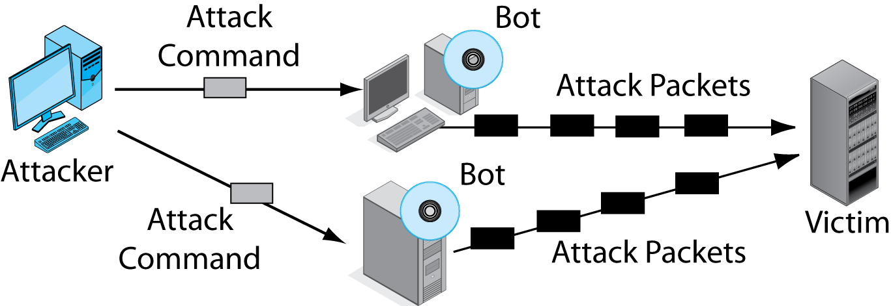
3.7: Distributed Denial-of-Service (DDoS) Attack Using Bots
Attacker (botmaster) sends attack commands to Bots.
Bots then attack victims.
Notes:
Read the bubble text.
Then go through the figures left to right.

Slide 39
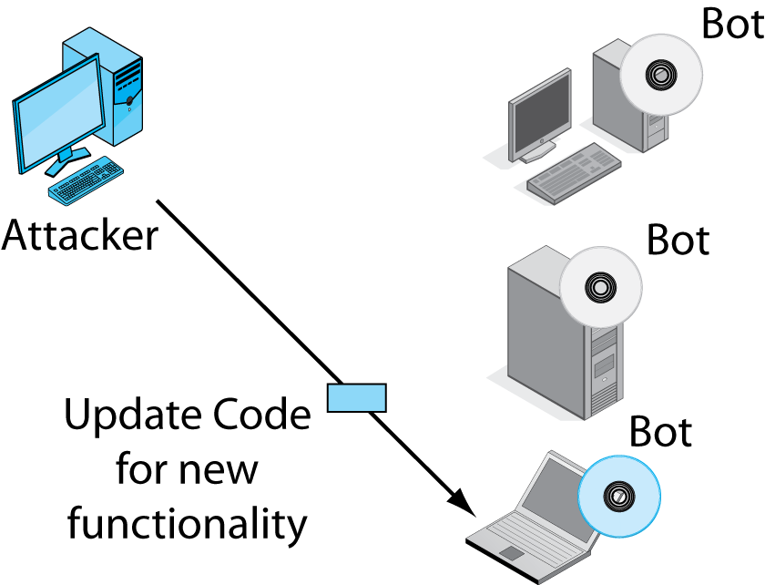

3.7: Distributed Denial-of-Service (DDoS) Attack Using Bots
Botmaster can even
update bots remotely
to give new functionality.
Notes:
Read the bubble text.
Then go through the figures left to right.

Slide 40
3.8: Types of Attackers
Traditional Attackers
Traditional Hackers
Driven by curiosity, desire for power, peer reputation
Malware Writers
It is usually not a crime to write malware.
It is almost always a crime to release malware.
Notes:
Read the text.

Slide 41

3.8: Types of Attackers
Traditional Attackers
Script kiddies
Use attack scripts written by experienced hackers and virus writers.
Scripts are easy to use, with GUIs.
Have limited knowledge and ability.
But large numbers make them dangerous.
Notes:
Read the text.

Slide 42
3.8: Types of Attackers
Traditional Attackers
Disgruntled Employees and Ex-Employees
Actions
Steal money and trade secrets
Sabotage systems
Dangerous because they have
Extensive access to systems, with privileges
Knowledge about how systems work
Knowledge about how to avoid detection
Notes:
Read the text.

Slide 43
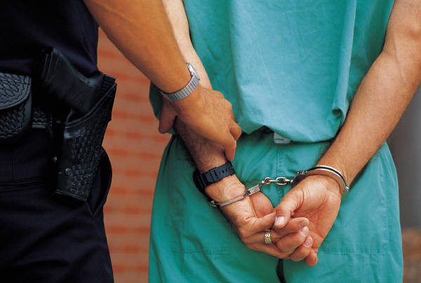
3.8: Types of Attackers
Criminal Attackers
Most attackers are now criminal attackers.
Attackers with traditional motives are now a small and shrinking minority.
Crime generates funds that criminal hackers need to increase attack sophistication.
Large and complex black markets for attack programs, attacks-for-hire services, bot rentals and sales, money laundering, and so on.
Notes:
Read the text.
Emphasize that attack is no longer “fun and games.” It is about criminals and money.

Slide 44
3.8: Types of Attackers
On the Horizon
Cyberattacks by cyberterrorists
Cyberattacks on utilities grids
Financial disruption
Cyberwar by nations
Espionage and attacks on utilities and financial infrastructures
Potential for massive attacks far larger than conventional cyberattacks
Notes:
Read the text.

Slide 45
Planning
Notes:
Go through the text next to Plan.
Emphasize that without really good planning, you cannot have adequate security.

Slide 46
3.9: Security Planning
Security Planning Principles
Risk Analysis
The process of balancing threat and protection costs for individual assets.
Annual cost of protection should not exceed the expected annual damage.
If probable annual damage is $10,000 and the annual cost of protection is $200,000, protection should not be undertaken.
Goal is not to eliminate risk but to reduce it in an economically rational level.
Notes:
Read the text.
Go slowly through this section. Emphasize both its importance and difficulty.

Slide 47
3.10: Risk Analysis Example
Countermeasure | None | A
Damage per successful attack | $1,000,000 | $500,000
Annual probability of a successful attack | 20% | 20%
Annual probability of damage | $200,000 | $100,000
Annual cost of countermeasure | $0 | $20,000
Net annual probable outlay | $200,000 | $120,000
Annual value of countermeasure |  | $80,000
Adopt the countermeasure? |  | Yes
Countermeasure A
cuts the damage per incident in half, but
does not change the frequency of occurrence.
Notes:
Go through the example from top to bottom.

Slide 48
3.10: Risk Analysis Example
Countermeasure | None | A
Damage per successful attack | $1,000,000 | $500,000
Annual probability of a successful attack | 20% | 20%
Annual probability of damage | $200,000 | $100,000
Annual cost of countermeasure | $0 | $20,000
Net annual probable outlay | $200,000 | $120,000
Annual value of countermeasure |  | $80,000
Adopt the countermeasure? |  | Yes
The net outlay is the cost of damage plus the cost of the countermeasure.
Notes:
Go through the example from top to bottom.

Slide 49
3.10: Risk Analysis Example
Countermeasure | None | B
Damage per successful attack | $1,000,000 | $1,000,000
Annual probability of a successful attack | 20% | 10%
Annual probability of damage | $200,000 | $100,000
Annual cost of countermeasure | $0 | $200,000
Net annual probable outlay | $200,000 | $300,000
Annual value of countermeasure |  | -$100,000
Adopt the countermeasure? |  | No
Countermeasure B
cuts the frequency of occurrence in half,
but does not change the damage per occurrence.
Notes:
Go through the example from top to bottom.

Slide 50
3.10: Risk Analysis Example
Countermeasure | None | B
Damage per successful attack | $1,000,000 | $1,000,000
Annual probability of a successful attack | 20% | 10%
Annual probability of damage | $200,000 | $100,000
Annual cost of countermeasure | $0 | $200,000
Net annual probable outlay | $200,000 | $300,000
Annual value of countermeasure |  | -$100,000
Adopt the countermeasure? |  | No
This time, the countermeasure is too expensive.
Notes:
Go through the example from top to bottom.

Slide 51
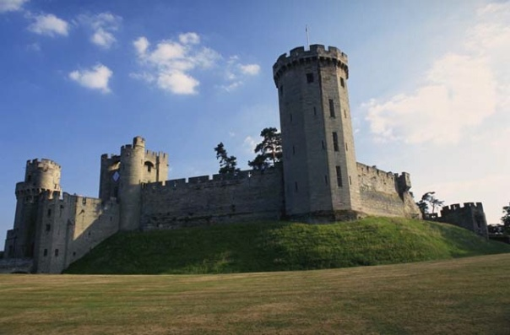
3.9: Security Planning
Security Planning Principles
Comprehensive security
An attacker only has to find one weakness to succeed.
A firm needs to close off all avenues of attack (comprehensive security).
This requires very good planning.
Notes:
Read the text.

Slide 52
3.9: Security Planning
Security Planning Principles
Defense in depth
Every protection breaks down sometimes.
The attacker should have to break through several lines of defense to succeed.
Even if one protection breaks down, the attack will not succeed.
Notes:
Read the text.

Slide 53
3.9: Security Planning
Granting Minimum Permissions
Access control is limiting who can use resources AND limiting their permissions while using resources.
Permissions are things they can do with the resource.
People should be given minimum permissions—the least they need to do their jobs—so that they cannot do unauthorized things.
Notes:
Read the text.

Slide 54

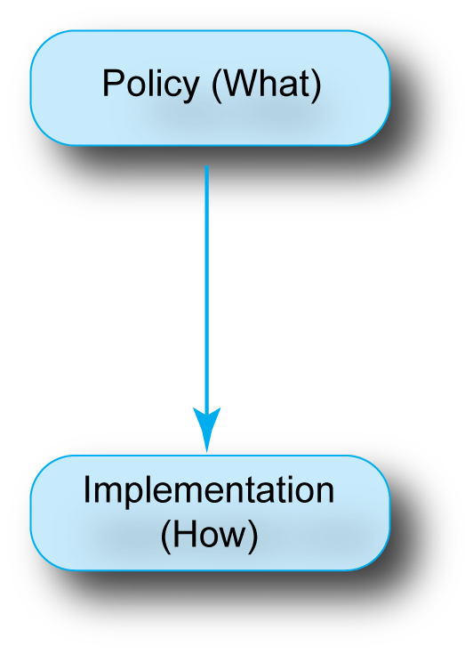
3.11: Policy-Based Security
Planners create policies, which specify what to do but not how to do it.
Policy-makers create policies with global knowledge.
Implementers implement policies with local and technical expertise.
Notes:
Blue bubbles first.
Then the red bubble.

Slide 55
3.11: Policy-Based Security
Policy Example
Use strong encryption for credit cards.
Implementation of the Policy
Choose a specific encryption method within this policy.
Select where in the process to do the encryption.
Choose good configuration options for the encryption method.
Notes:
Read the text.

Slide 56
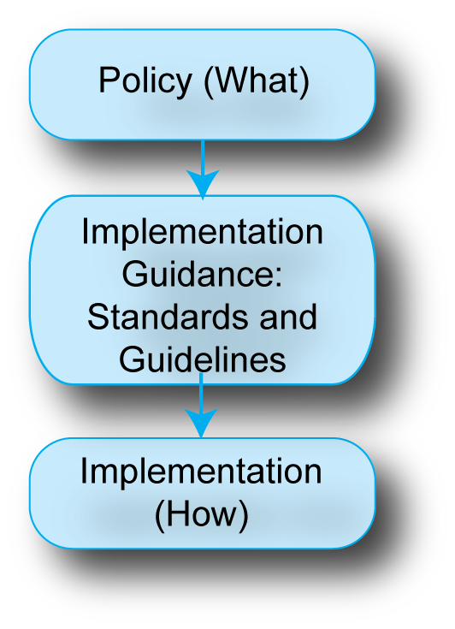
3.11: Policy-Based Security
Implementation guidance goes beyond pure “what” by constraining to some extent the “how”.
For example, it may specify that encryption keys must be more than 100 bits long.
Constrains implementers so they will make reasonable choices.
Notes:
Go through the blue bubbles top to bottom.
Then go through the red bubble.

Slide 57
3.11: Policy-Based Security
Implementation Guidance has two forms.
Standards MUST be followed by implementers.
Guidelines SHOULD be followed, but are optional.
However, guidelines must be considered carefully.
Notes:
Go through the blue bubbles top to bottom.
Then go through the red bubble.

Slide 58
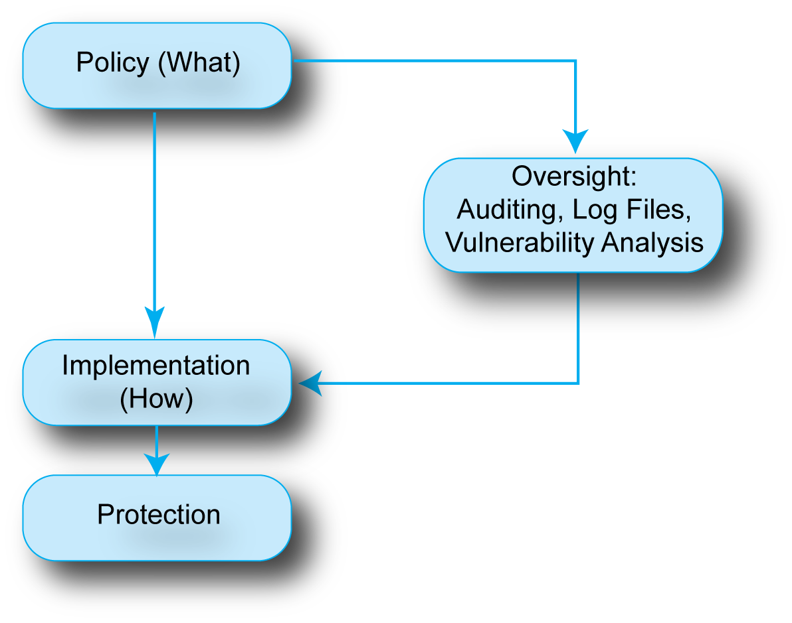
3.11: Policy-Based Security
Oversight checks that policies are being implemented successfully.
Good implementation +
Good oversight =
Good protection
Notes:
Go through the blue bubbles top to bottom.
Then go through the red bubbles.

Slide 59
3.11: Policy-Based Security
Policies are given to implementers and oversight staff independently.
Oversight may uncover implementation problems or problems with the specification of the policy.
Notes:
Go through the blue bubbles top to bottom.
Then go through the red bubbles.

Slide 60
Protecting
Notes:
Protection is the implementation of policies.
Read the text by Protect.

Slide 61
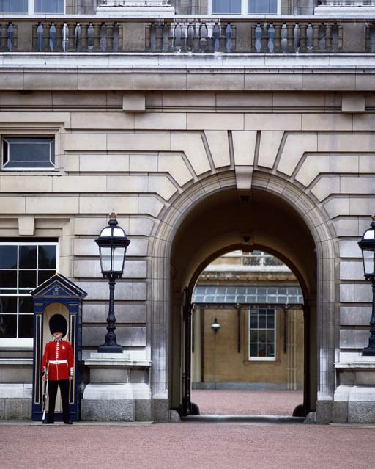
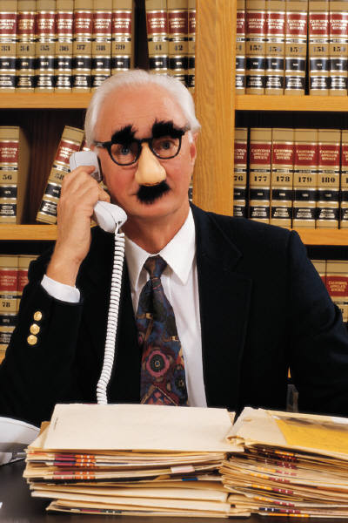
Access Control
Controlling Access to Resources
If criminals cannot get access, they cannot do harm.
Authentication
Proving one’s identity
Cannot see the other party
Notes:
Read the text.

Slide 62
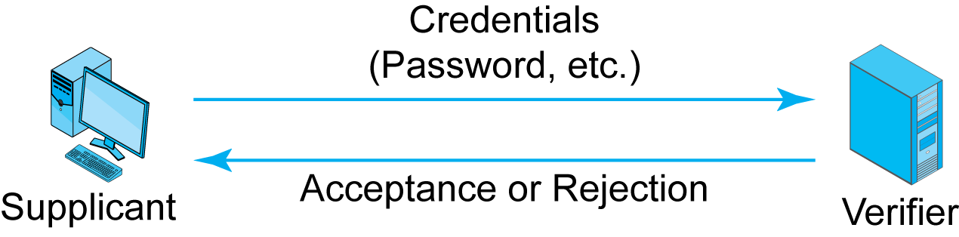
3.12: Authentication
The supplicant proves its identity to the verifier by sending its credentials (proofs of identity).
Notes:
Read the text.
Then go through the figure left to right.

Slide 63

3.13: Password Authentication
Reusable Passwords
Strings of characters typed to authenticate the use of a username (account) on a computer.
They are used repeatedly and so are called reusable passwords.
Benefits
Ease of use for users (familiar)
Inexpensive because built into operating systems
Notes:
Read the text.

Slide 64

3.13: Password Authentication
Often Weak (Easy to Crack)
Word and name passwords are common.
spot, mud, helicopter, veterinarian
They can be cracked quickly with dictionary attacks.
Word and name passwords are never adequately strong, regardless of how long they are.
Notes:
Read the text.
Emphasize the outlined material. Note that students have a hard time understanding it.

Slide 65
3.13: Password Authentication
Hybrid Dictionary Attacks
Look for common variations of names and words.
Capitalizing only the first letter
Ending with a single digit
And so on
Passwords that can be cracked with hybrid dictionary attacks are never adequately strong, regardless of how long they are.
Notes:
Read the text.
Emphasize the outlined material. Note that students have a hard time understanding it.

Slide 66
3.13: Password Authentication
Adequate Passwords Are Complex
Should mix case, digits, and other keyboard characters ($, #, etc.).
Complex passwords can be cracked only with brute force attacks (trying all possibilities).
Adequate Passwords Are Also Long
Should have a minimum of eight characters.
Each added character increases the brute force search time by a factor of about 70.
Notes:
Read the text.

Slide 67
3.13: Password Authentication
For each password, how would it be cracked, and is it acceptably strong:
Mississippi
Larry52
4$5aB
34d8%^tdy
Notes:
Mississippi Common Name Common names are never acceptably strong. Length means nothing.
4$5aB Complex Not acceptably strong—too short.
34d8%^tdy Complex and long Acceptably strong. (But you might note that people may write it down.)

Slide 68
3.13: Password Authentication
Other Concerns
If people are forced to use long and complex passwords, they tend to write them down.
People should use different passwords for different sites.
Otherwise, a compromised password will give access to multiple sites.
Overall, reusable passwords are too vulnerable to be used for high security today.
Notes:
Read the text.
Emphasize the last point. It is important because the goal of other authentication controls is to replace reusable passwords.

Slide 69
3.14: Other Forms of Authentication
Perspective
Goal is to eliminate reusable passwords.
Access Cards
Permit door access.
Proximity access cards do not require physical scanning.
Need to control distribution and disable lost or stolen cards.
Notes:
Go through the text.
Emphasize the first point.

Slide 70

3.14: Other Forms of Authentication
Biometrics
Uses body measurements to authenticate you
Methods vary in cost, precision, and ease of deception
Fingerprint scanning
Inexpensive but poor precision, deceivable
Sufficient for low-risk uses
On a notebook, may be better than requiring a reusable password
Notes:
Go through the text.
Emphasize the last point—go slowly because it is a bit complex.

Slide 71
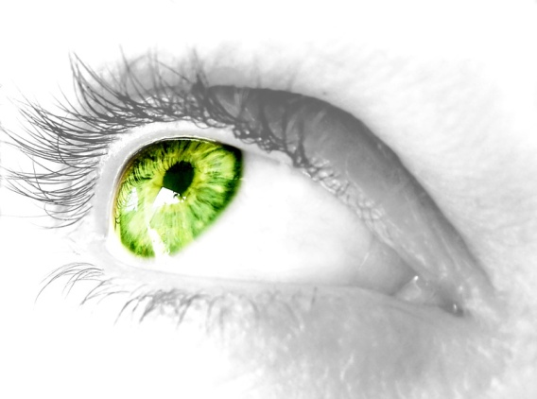

3.14: Other Forms of Authentication
Biometrics
Iris scanning
Patterns in the colored part of your eye
Expensive but precise and difficult to deceive
Facial scanning
Based on facial features
Controversial because it can be done surreptitiously—without the scanned person’s knowledge
Notes:
Go through the text.
Emphasize the last point.

Slide 72



3.14: Other Forms of Authentication
Digital Certificate Authentication
The strongest form of authentication
Components
Everyone has a private key only he or she knows.
Everyone also has a non-secret public key.
If John communicates with Sylvia, how many public and private keys will there be?
If there are 20 students in the classroom, how many public and private keys will there be?
Notes:
Go through the text.
There will be 20 public keys and 20 private keys.

Slide 73
3.14: Other Forms of Authentication
Digital Certificate Authentication
Components
Public keys are available in unalterable digital certificates.
Digital certificates are provided by trusted certificate authorities.
Notes:
Go through the text.

Slide 74

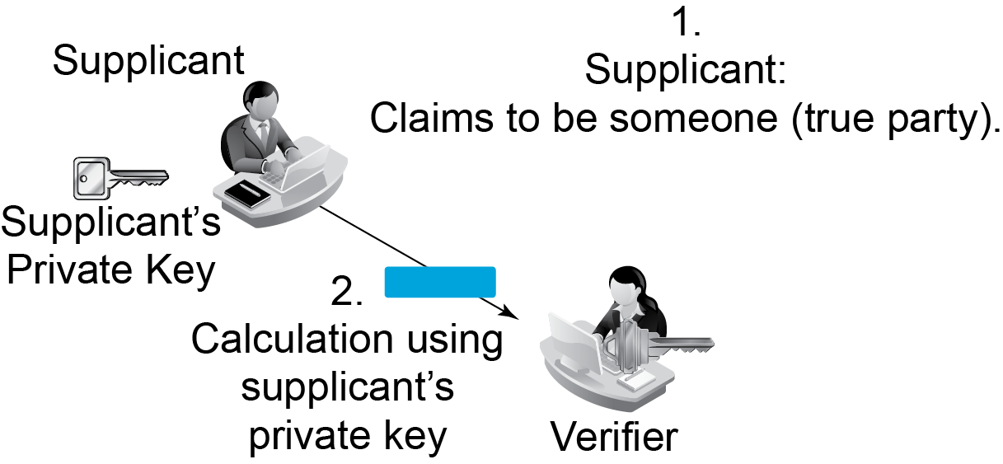
3.15: Digital Certificate Authentication
Notes:
Note the supplicant and the verifier.
Go through Point 1. Emphasize the meaning of the true party.
Go through Point 2.

Slide 75
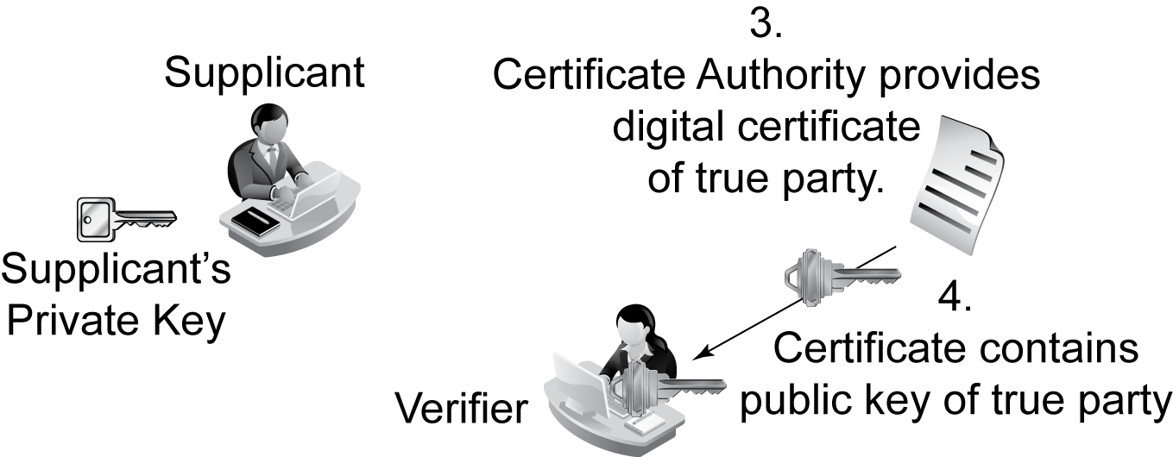
3.15: Digital Certificate Authentication
Verifier gets the public key of
the true party from the true party’s digital certificate.
Notes:
Go through 3 and 4.

Slide 76

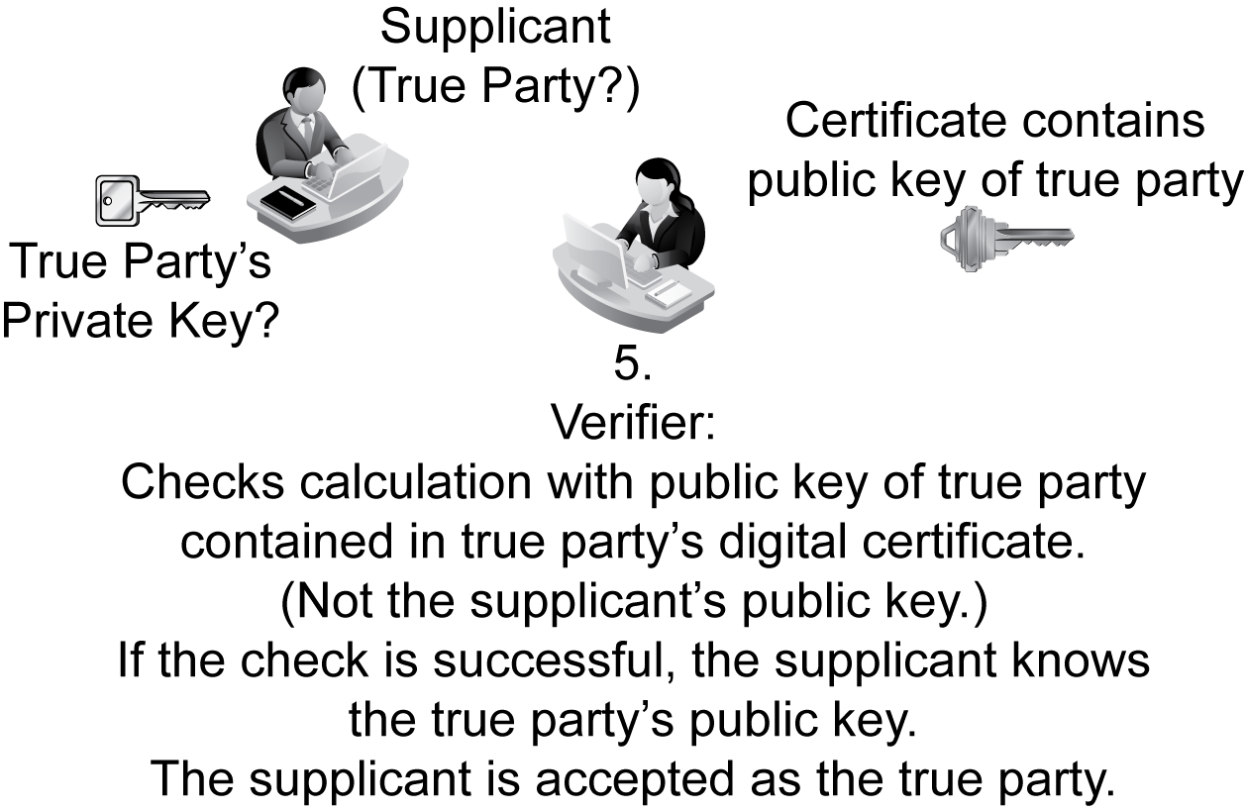
3.15: Digital Certificate Authentication
Notes:
Go through 5 very slowly.
Note that the calculation is done with the supplicant’s private key but is tested with the true party’s public key.

Slide 77
3.14: Other Forms of Authentication
Two-Factor Authentication
Supplicants need two forms of credentials
Example: debit card and PIN
Strengthens authentication (defense in depth)
Fails if attacker controls the user’s computer or
Intercepts the authentication communication
+
4400
(PIN)
= 2-Factor Authentication
Notes:
Go through the text.

Slide 78
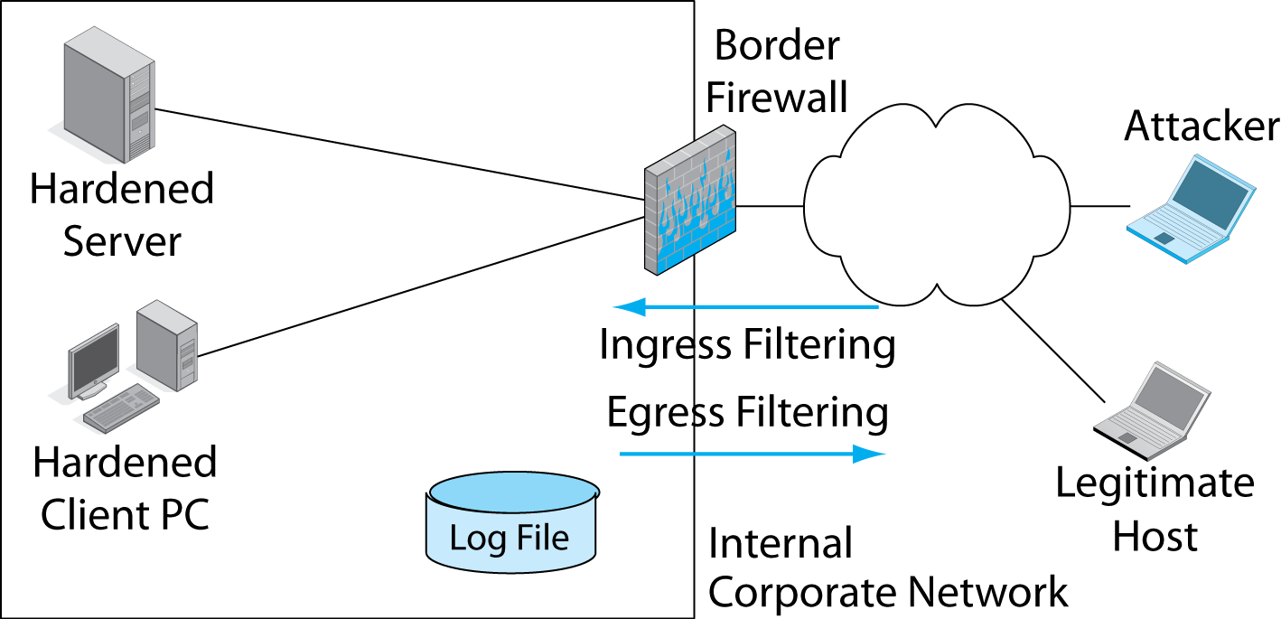
3.16: Firewall
Firewall examines all packets passing through it.
Notes:
Read the text in the red rectangle.
Then show the outlined definitions of ingress and egress filtering.

Slide 79
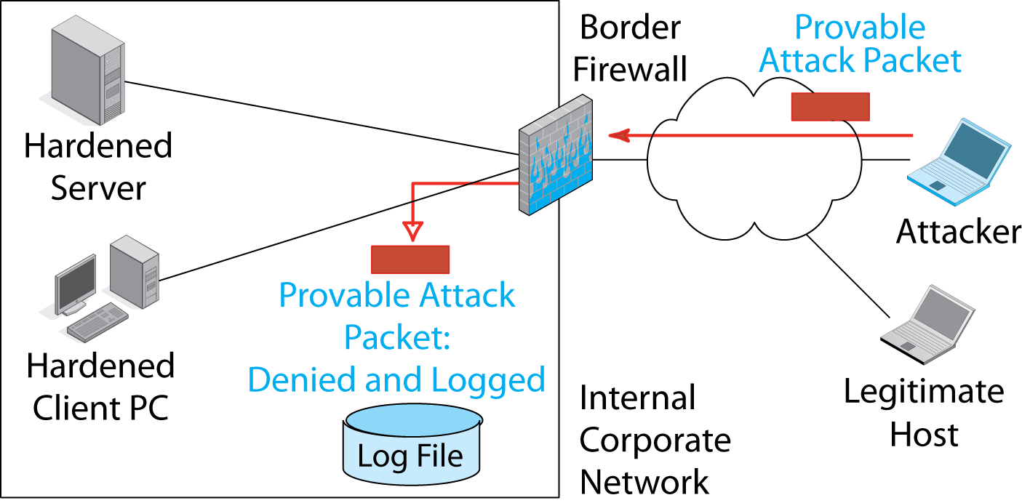
3.16: Firewall
Drops and logs
provable attack packets
Notes:
Note that it only drops and logs provable attack packets.

Slide 80
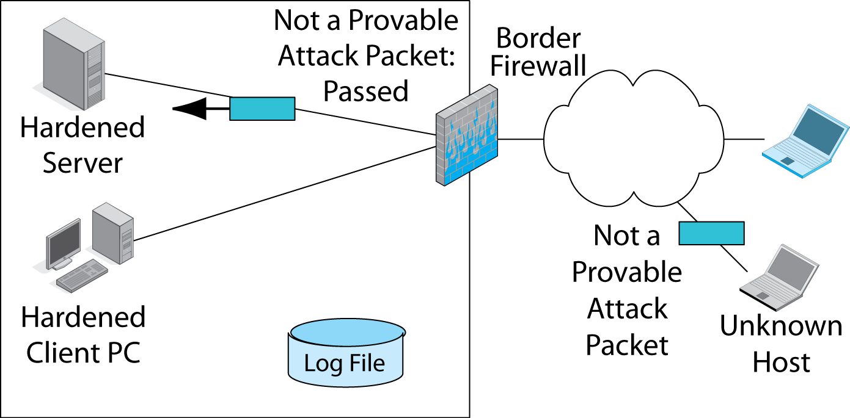
3.16: Firewall
Passes packets that are not provable attack packets
Notes:
Read the red rectangle.

Slide 81

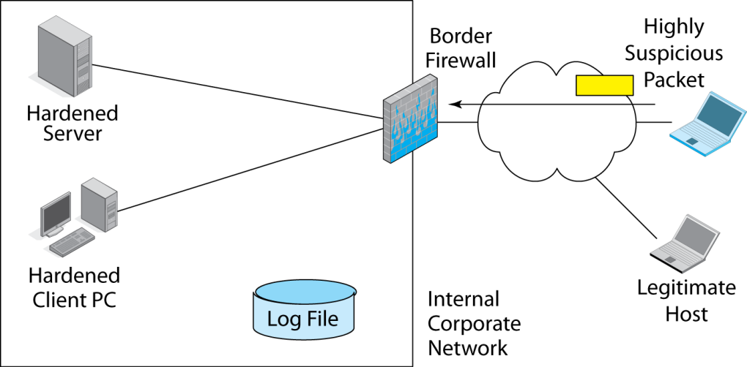
3.16: Firewall
What does a firewall do with a packet that is highly suspicious?
Notes:
The answer is that if the packet is highly suspicious, it is still not provable.
Only provable attack packets are dropped and logged.
Highly suspicious packets are merely passed.

Slide 82
Firewall Filtering Mechanisms
Firewalls Inspect Packets.
There are several firewall filtering (inspection) methods.
We will look at three.
Static packet filtering is inexpensive, insufficient.
Stateful Packet Inspection (SPI) is the most common filtering mechanism.
Deep inspection firewalls.
Notes:
Read the text.

Slide 83
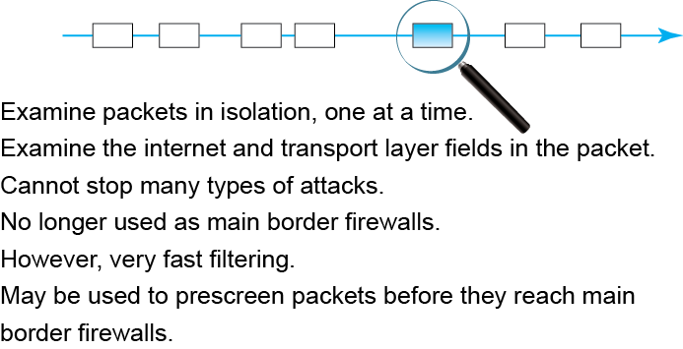
3.17: Static Packet Filtering

Slide 84
Firewall Filtering Mechanisms
Stateful Packet Inspection
The most common firewall inspection mechanism.
Conversations have different states.
On the telephone, there is the initial determination of who the other party is.
Afterward, identity does not have to be checked.
Data conversations also have different states with different security requirements.
Notes:
Read the text.

Slide 85
Stateful Packet Inspection
Connections have states with different security needs.
During connection openings, there has to be very careful authentication and other status checking.
After the connection opening, heavy authentication and other status checking is unnecessary.
Stateful Packet Inspection (SPI) basic insight: only do heavy filtering for risky stages of a connection.
Notes:
Read the text.
Emphasize the last point.

Slide 86
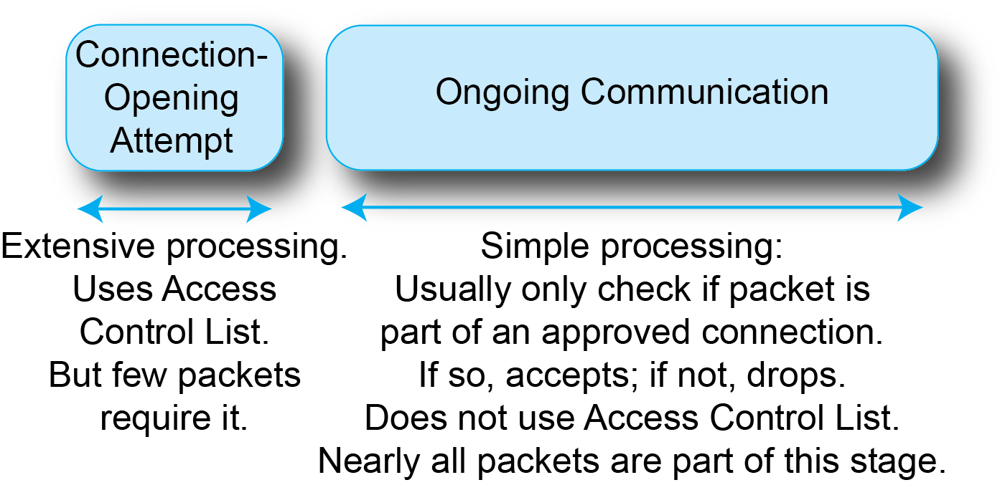
3.18: Connection States
Notes:
Go through the bubbles and text from left to right.

Slide 87
3.19: Access Control List (ACL)
For all packets that attempt to open a connection
Not for the more numerous packets that do not attempt to open a connection
Rule | Destination IP Address or Range | Service (Port) | Action
1 | ALL | 25 | Allow Connection
2 | 10.47.122.79 | 80 | Allow Connection
3 | ALL | ALL | Do Not Allow Connection
Notes:
Go through the text and then the table, top to bottom.

Slide 88
3.20: Stateful Inspection for Packets that Do Not Attempt to Open a Connection
If packet does not attempt to open a connection…
If the packet is part of an accepted connection,
Pass without further inspection (although may do further inspection if desired)
Otherwise, drop and log
Notes:
Read the text.

Slide 89
3.20: Stateful Inspection for Packets that Do Not Attempt to Open a Connection
Nearly all packets are NOT part of connection-opening attempts.
Simplicity of filtering for packets that do not attempt to open connections makes cost of processing most packets low.
At the same time, there is heavy filtering at the initial state, which needs heavy filtering.
The result is good security and good cost.
Notes:
Read the text.

Slide 90
Stateful Packet Inspection Recap
All Packets
Packets that Attempt
to Open a Connection
Other Packets
Part of
Previously
Permitted
Connection
Not Part of
Previously
Permitted
Connection
Pass Through
Access Control List
Accept or Reject
Connection
Accept Packet
Drop Packet
Notes:
Go through the figure from top to bottom and the left to right.

Slide 91
Stateful Packet Inspection Recap
What does an SPI firewall do with a packet containing a SYN segment?
All Packets
Packets that Attempt
to Open a Connection
Other Packets
Part of
Previously
Permitted
Connection
Not Part of
Previously
Permitted
Connection
Pass Through
Access Control List
Accept or Reject
Connection
Accept Packet
Drop Packet
Notes:
Go through the figure from top to bottom and the left to right.

Slide 92
Stateful Packet Inspection Recap
What does an SPI firewall do with a packet containing an ACK segment?
All Packets
Packets that Attempt
to Open a Connection
Other Packets
Part of
Previously
Permitted
Connection
Not Part of
Previously
Permitted
Connection
Pass Through
Access Control List
Accept or Reject
Connection
Accept Packet
Drop Packet
Notes:
Go through the figure from top to bottom and the left to right.

Slide 93
3.21: Deep Inspection Firewalls
Examine Streams of Messages
Stateful inspection firewalls know packet context (connection-opening or not) but still examine only individual packets.
Deep inspection firewalls look at streams of packets for patterns.
For example, reconstruct application messages from TCP segments in different packets.

Slide 94
3.21: Deep Inspection Firewalls
Read All Packet Layers, Including Application Messages
Stateful packet inspection packets do not read application messages in detail.
Deep inspection firewalls examine application messages in detail.
This allows them to tell when a message to Port 80 is not an HTTP message.
These may use Port 80 for illegal file sharing and other attacks.

Slide 95
3.21: Deep Inspection Firewalls
Read All Packet Layers, Including Application Messages
Some deep inspection packets are application-aware, allowing administrators to set up filtering rules for many specific applications.
This provides very powerful control.

Slide 96
3.21: Deep Inspection Firewalls
Intrusion Detection Systems (IDSs)
Deep inspection firewalls began as intrusion detection systems (IDSs)
Found suspicious patterns in traffic and notified the firewall administrators
Did not drop packets

Slide 97
3.21: Deep Inspection Firewalls
Intrusion Detection Systems (IDSs)
Have evolved to the point where they can be allowed to stop highly suspicious traffic
Must be done carefully but can be effective
For example, a denial-of-service attack can be detected with high confidence

Slide 98
3.21: Deep Inspection Firewalls
Require Extensive Processing Power
Far more than SPI
Made possible by application-specific integrated circuits (ASICs)
ASICs handle specific deep firewall inspection tasks in specialized hardware, which is very fast
Finally making deep inspection feasible

Slide 99

Cryptography
Group of Protections Based on Mathematics
Confidentiality: eavesdropper cannot read transmissions.
Authentication: identity of the sender is proven.
Message Integrity: receiver can tell if the message has been altered en route.
Collectively called CIA.
Notes:
Read the text.

Slide 100

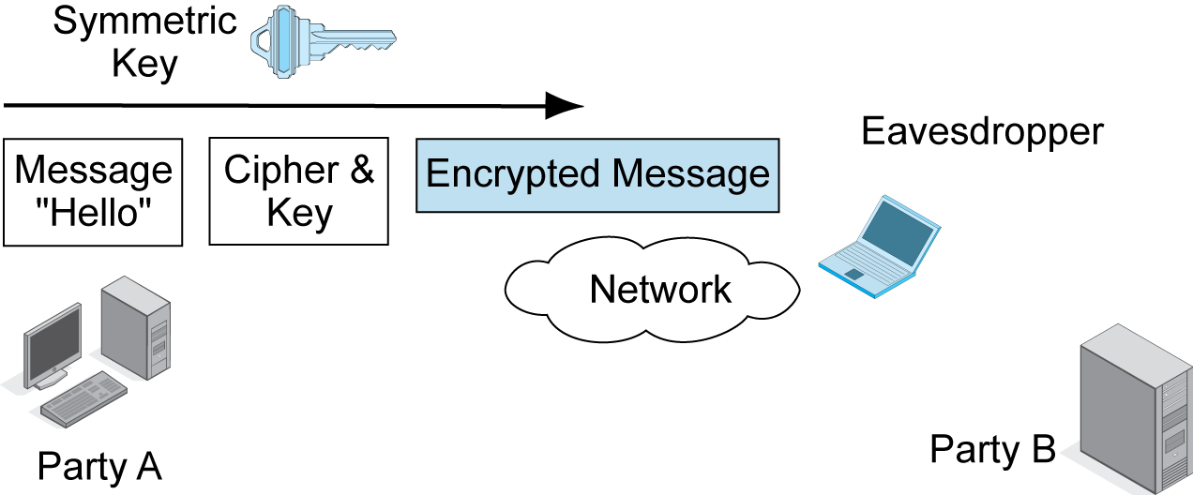
3.22: Symmetric Key Encryption for Confidentiality
Encryption methods are called ciphers, not codes.
Notes:
Go through the figure from left to right.

Slide 101

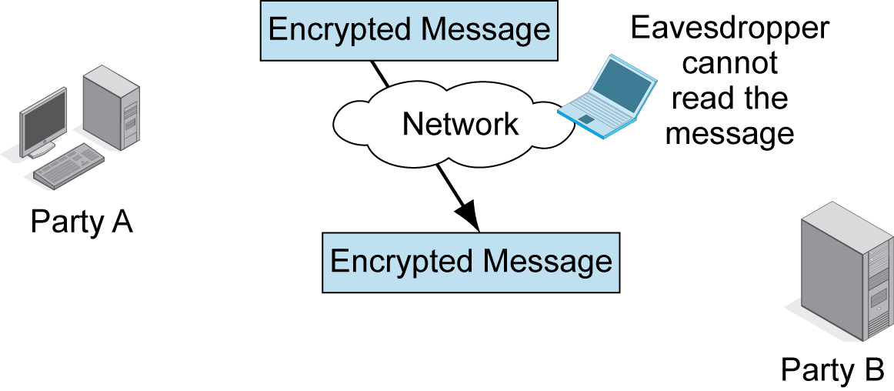
3.22: Symmetric Key Encryption for Confidentiality
Encrypted messages
thwart eavesdroppers.
Notes:
Go through the figure from top to bottom.

Slide 102
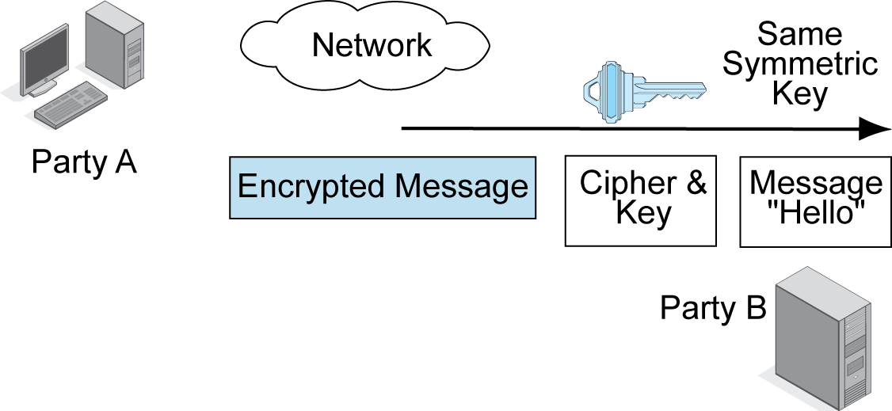
3.22: Symmetric Key Encryption for Confidentiality
Receiver decrypts with the same cipher and symmetric key.
Notes:
Read the figure from left to right.

Slide 103
3.22: Symmetric Key Encryption for Confidentiality
Notes
A single key is used to encrypt and decrypt in both directions.
The most popular symmetric key encryption cipher today is the Advanced Encryption System (AES).
Key lengths have to be at least 100 bits long to be considered strong.
Notes:
Read the text.
Emphasize the first point.

Slide 104
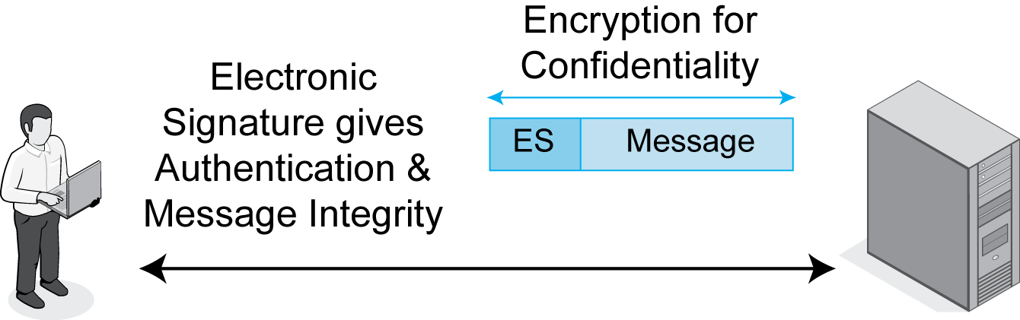
3.23: Electronic Signature
Notes:
Describe the figure.

Slide 105
3.23: Cryptographic Systems
Cryptographic Systems
Packages of Cryptographic Protections
Users do not have to know the details
Defined by cryptographic system standards
Examples of Cryptographic System Standards
SSL/TLS
IPsec
Notes:
Read the text.

Slide 106
Incident Response
Notes:
Show that we are going into the Respond stage.
Define incidents, compromises, and breaches.

Slide 107
Incident Response
Some attacks inevitably succeed.
Successful attacks are called incidents or compromises.
Security moves into the respond stage.
Response should be “reacting according to plan.”
Planning is critical.
A compromise is not the right time to think about what to do.
Notes:
Read the text.

Slide 108
3.24: Incident Response
Stages
Detecting the attack
Stopping the attack
Repairing the damage
Punishing the attacker?
Notes:
Read the text.
Show the progression on the left.

Slide 109
3.24: Incident Response
Major Incidents and CSIRTs
Major incidents are incidents the on-duty security staff cannot handle.
Company must convene a computer security incident response team (CSIRT).
CSIRTs should include members of senior management, the firm’s security staff, members of the IT staff, members of affected functional departments, and the firm’s public relations and legal departments.
Notes:
Read the text.

Slide 110
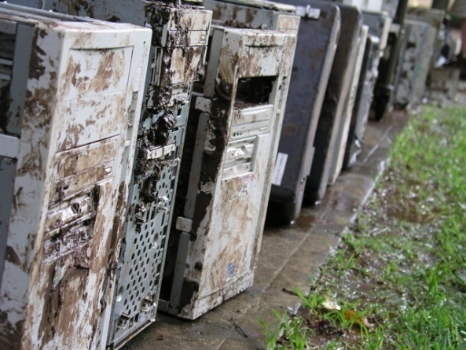
3.24: Incident Response
Disasters and Disaster Recovery
Natural and humanly made disasters
IT disaster recovery
Dedicated backup sites and transferring personnel or
Having two sites mutually back up each other
Business continuity recovery
Getting the whole firm back into operation
IT is only one concern
Notes:
Read the text.
Be clear that there is a distinction between IT disaster recover and business continuity recovery.

Slide 111
3.24: Incident Response
Rehearsals
Incident response is responding according to plan.
Rehearsals are necessary for accuracy.
To find problems with the plan.
Rehearsals are necessary for response speed.
Time literally is money.
Notes:
Read the text.
Rehearsal is absolutely critical.

Slide 112
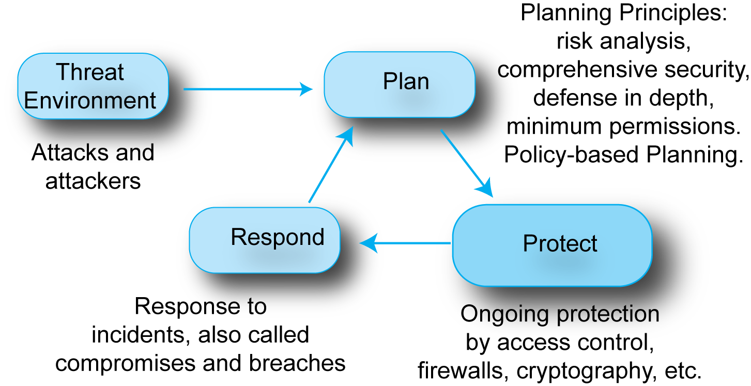
Where We’ve Been
Notes:
Do the recap.

Slide 113
Where We’re Going Next
Chapter 1: General concepts and principles
Chapter 2: Standards
Chapter 3: Security
Chapter 4: Network Management
In Chapter 4, with previous chapters as background, will focus on designing and managing networks.
Notes:
Show the flow.

Slide 114
